Slide 1
RIT · ROCHESTER INSTITUTE OF TECHNOLOGY
AI-Powered
Data Analysis
Internship
Final Presentation and Insight Report
TEAM 6 · Week 4
Student Participation Dataset
Notes:
This presentation summarizes the analysis of the student participation dataset, the patterns found, the limits of the modeling, and the operating choices that follow.

Slide 2
INTRODUCTION
Three questions frame the analysis
The purpose was to analyze historical learner applications and engagement dataset to identify different relations and establish the patterns found during the analysis.
Where is demand concentrated?
When does demand peak?
What should program managers do about it?
Approach · clean and explore the data, compare countries, time periods, and opportunity categories, then test predictive models.
02
Notes:
Use the three questions as the structure for the presentation. We first describe where and when participation appears, then close with what program managers can do and how much confidence to place in the model outputs.

Slide 3
KEY INSIGHTS
Executive summary
RIT Student Participation, Team 6 | Random Forest model, XGBoost as cross-check
~87%
Demand is concentrated
Internships and Courses make up about 87% of applications.
Q1
Demand peaks in Q1
Q1 holds about 58% of applications, with a secondary peak in Q3.
Peak confirmed
The model confirms the Q1 peak
It underestimates sudden surges, so exact future volumes are low confidence.
42% / <9%
Conversion is the bottleneck
42% of applications are rejected and under 9% reach "Started".

Slide 4
PERFORMANCE INDICATORS
Executive summary KPIs
RIT Student Participation Dataset, Team 6
8,553
Internship
63.4%
Q1
Total application records
Top opportunity category
Top category share of applications
Peak quarter (~58% of applications)
8.9%
Oct 2022 to Apr 2024
Saint Louis University
Start rate (764 started)
Application period
Top university (4,368 learners, ~51%)
Start rate = records with status "Started" / all records. Quarterly share uses 8,405 records with valid application dates.

Slide 5
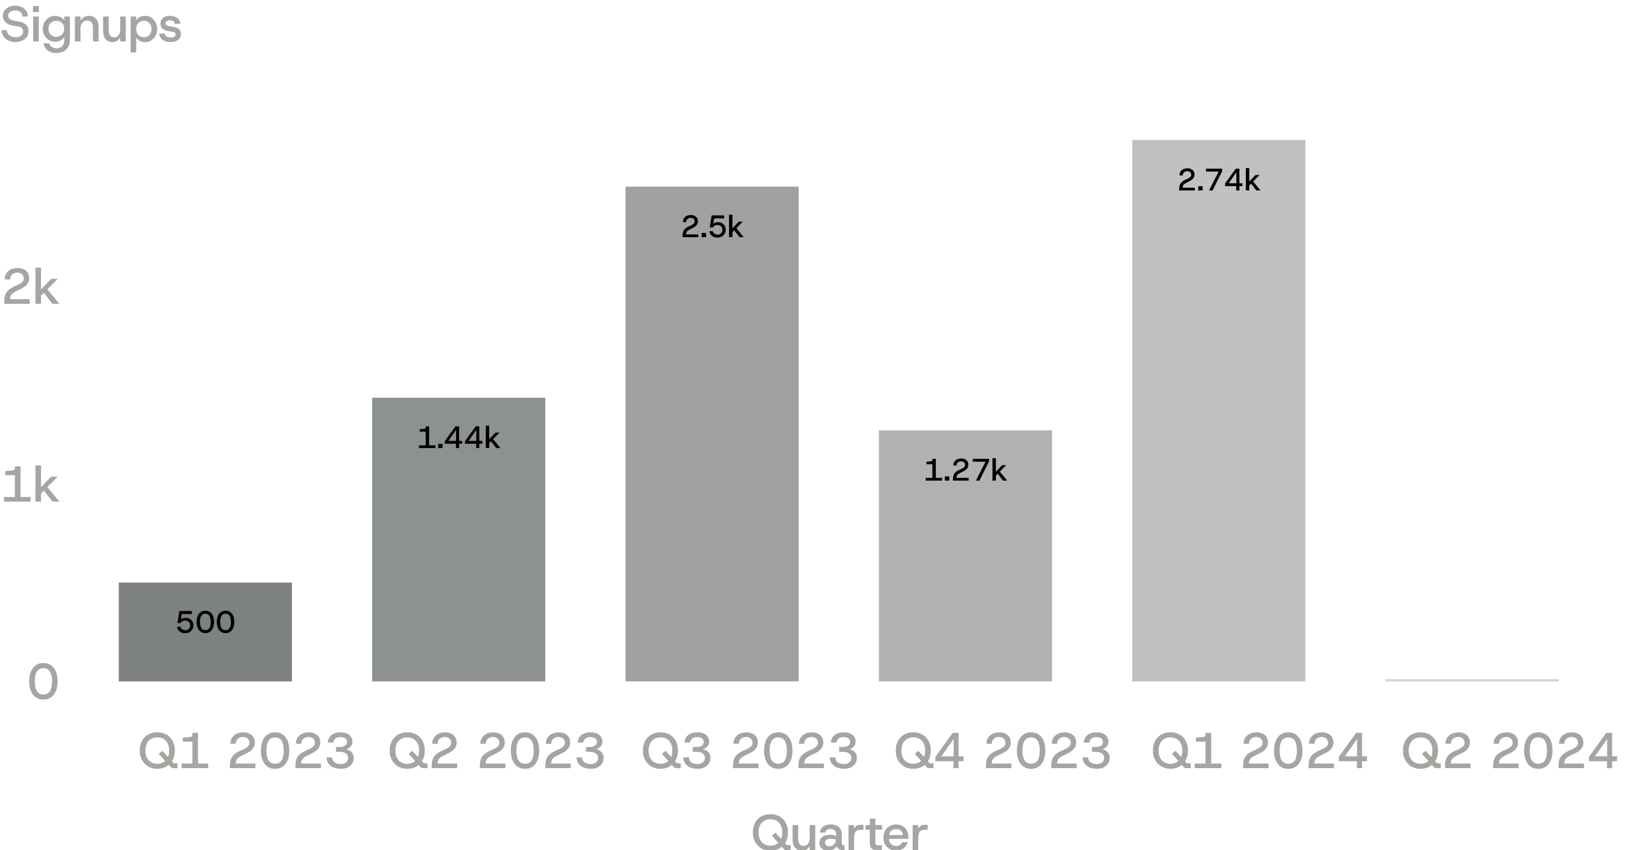
HISTORICAL PARTICIPATION
Participation rose sharply, but Q2 2024 is incomplete
1,133
1,547
August 2023
January 2024
signups
signups
Largest complete-quarter volume: 2024 Q1. 2024 Q2 is incomplete and should not be compared directly.
03
Notes:
Participation fluctuated, but the largest complete-quarter volume appears in 2024 Q1. The 11 records in Q2 2024 reflect an incomplete period, so they are not a comparable quarter.

Slide 6
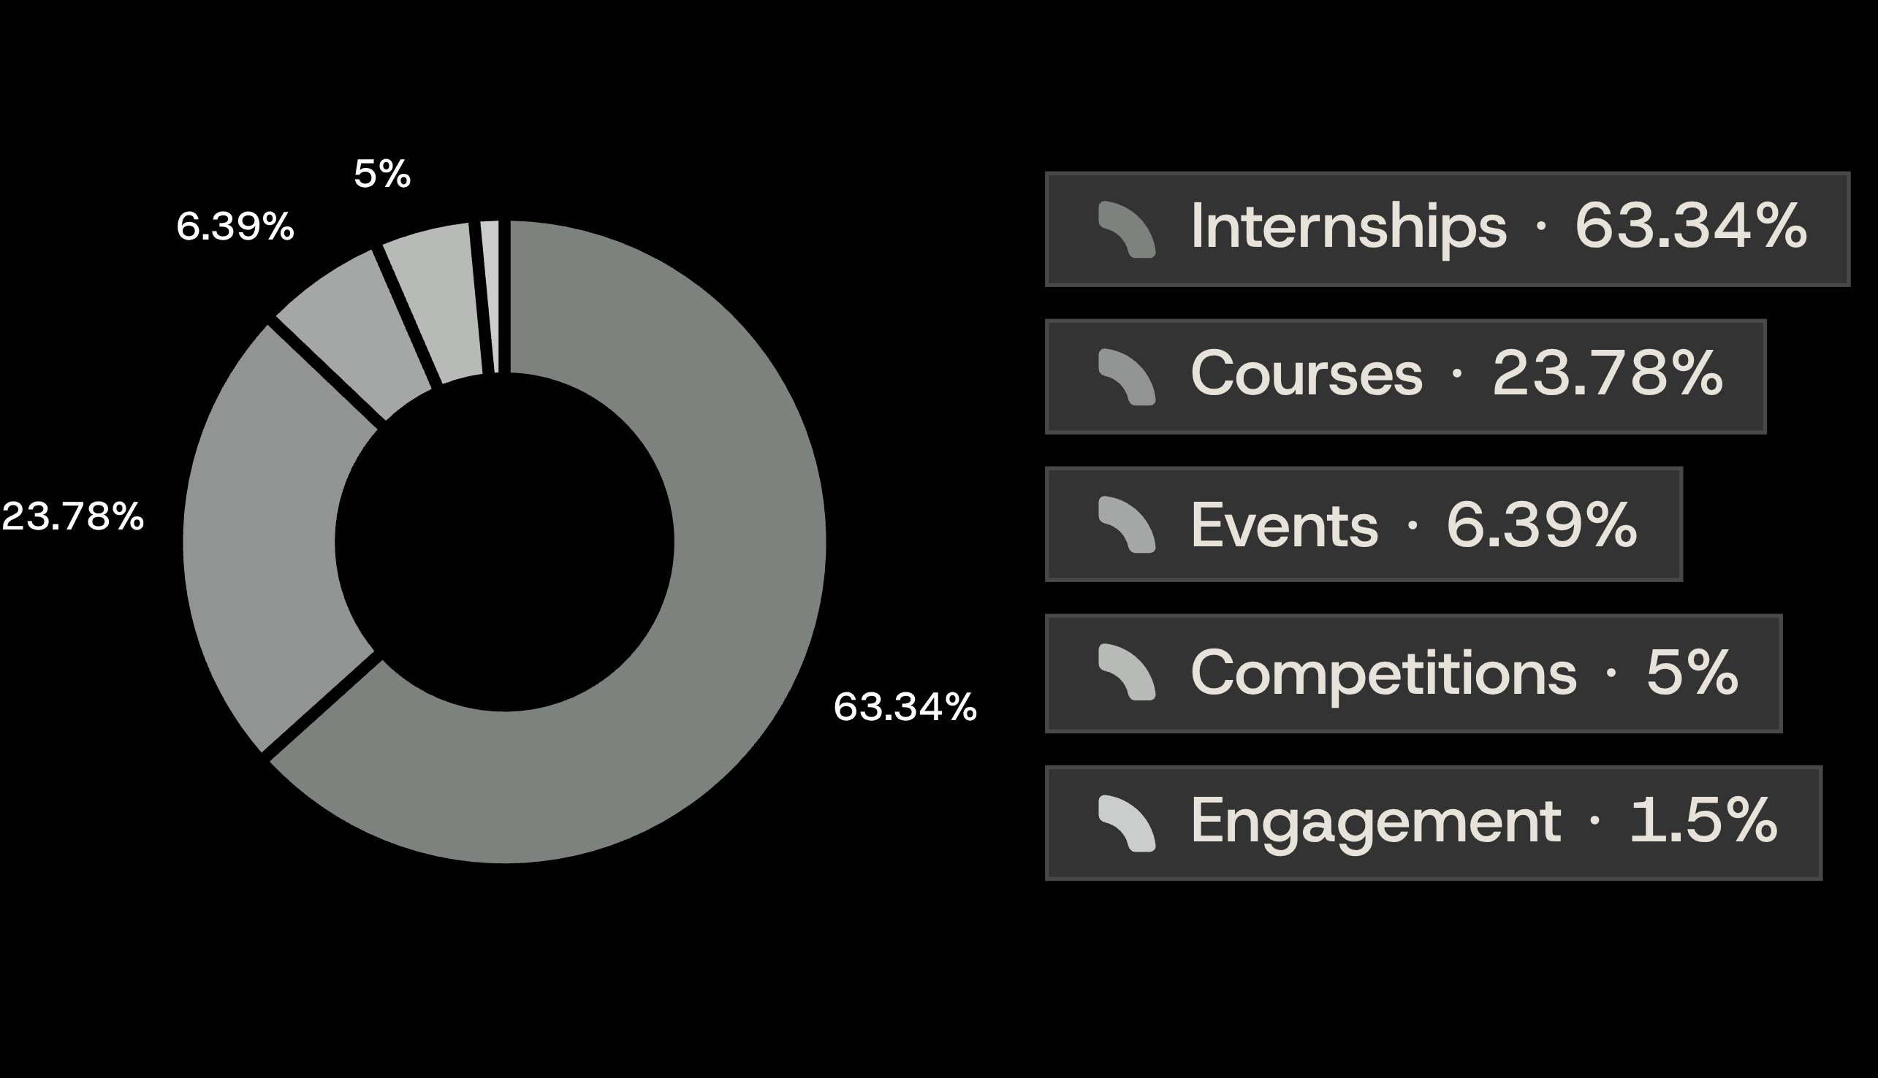
DEMAND CONCENTRATION
Demand is concentrated in two countries and two opportunity types
United States
3,976 learners
India
2,832 learners
Rwanda: 28 learners
Internships and courses together represent approximately 87.2% of participation.
04
Notes:
The concentration appears in both geography and opportunity type. The United States and India account for the largest listed learner counts, while internships and courses together account for approximately 87.2% of participation.

Slide 7
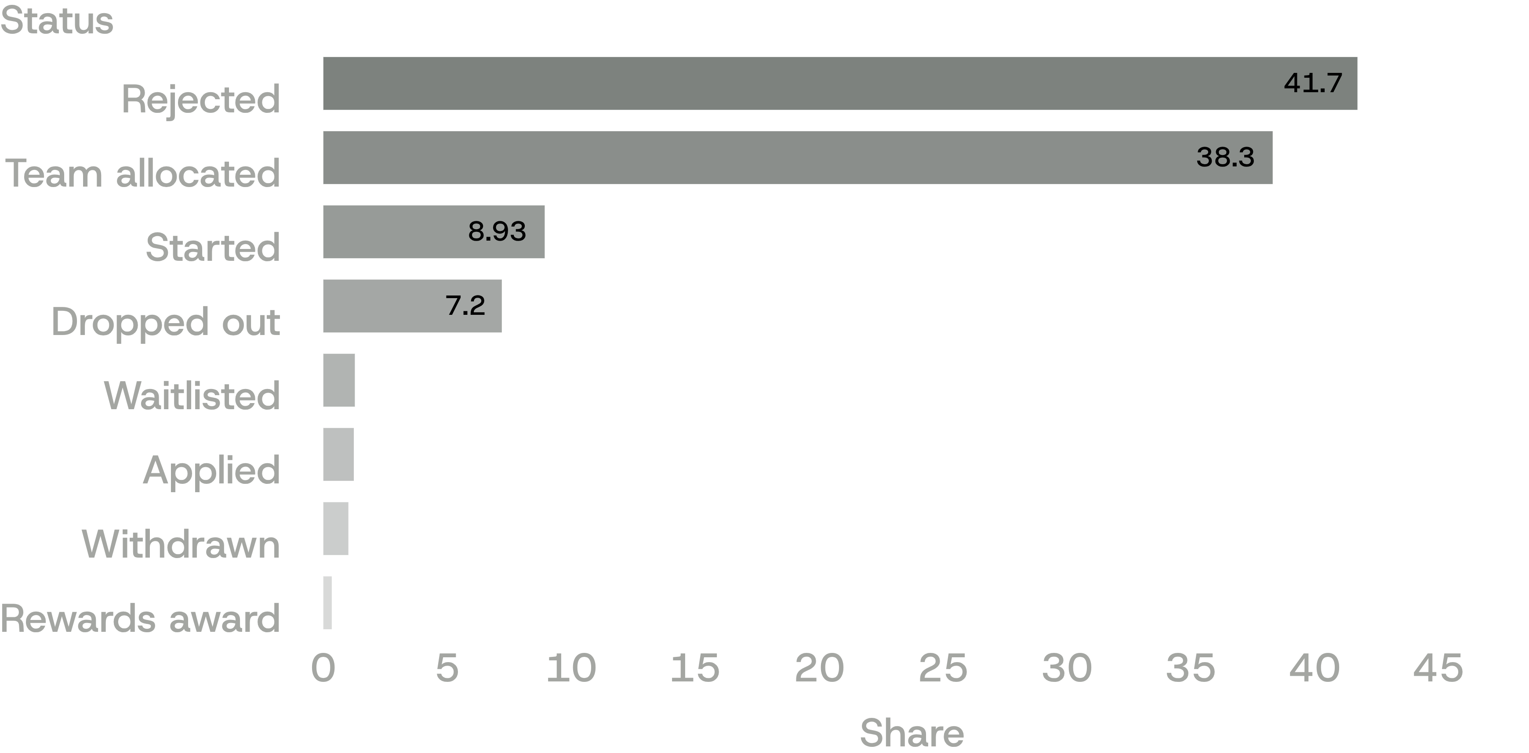
OBSERVED STATUS MIX
Rejection and allocation dominate the observed statuses
7.2%
Dropout records
Focus question: where do they cluster?
The distribution identifies areas for investigation but does not establish causes.
05
Notes:
Rejected and team-allocated records are the two largest observed groups. The 7.2% dropout share is important to investigate, but this distribution alone does not explain why any status occurred.

Slide 8
SEASONAL PATTERNS
Application activity follows different seasonal patterns by category
January and February are major periods of overall application activity; August 2023 and January 2024 were notable historical peaks.
Internships
Courses
Events and competitions
≈1,400
≈394
≈113 / ≈105
learners in January
learners in June
February peaks
≈780 in August
Events / competitions
Keep signup-date analysis distinct from opportunity-category engagement analysis.
06
Notes:
Seasonality differs by category. Internship demand peaks around January and August, courses peak in June, and events and competitions peak in February. These are different analytical views and should remain separate.

Slide 9
SEASONAL ANALYSIS
Internships drive both seasonal peaks: January and August
Peak-month learners by category
Internship (Jan)
1,404
Internship (Aug)
782
Course (Jun)
394
Event (Feb)
113
Competition (Feb)
105
Source: Week 2 seasonal behaviour chart

Slide 10
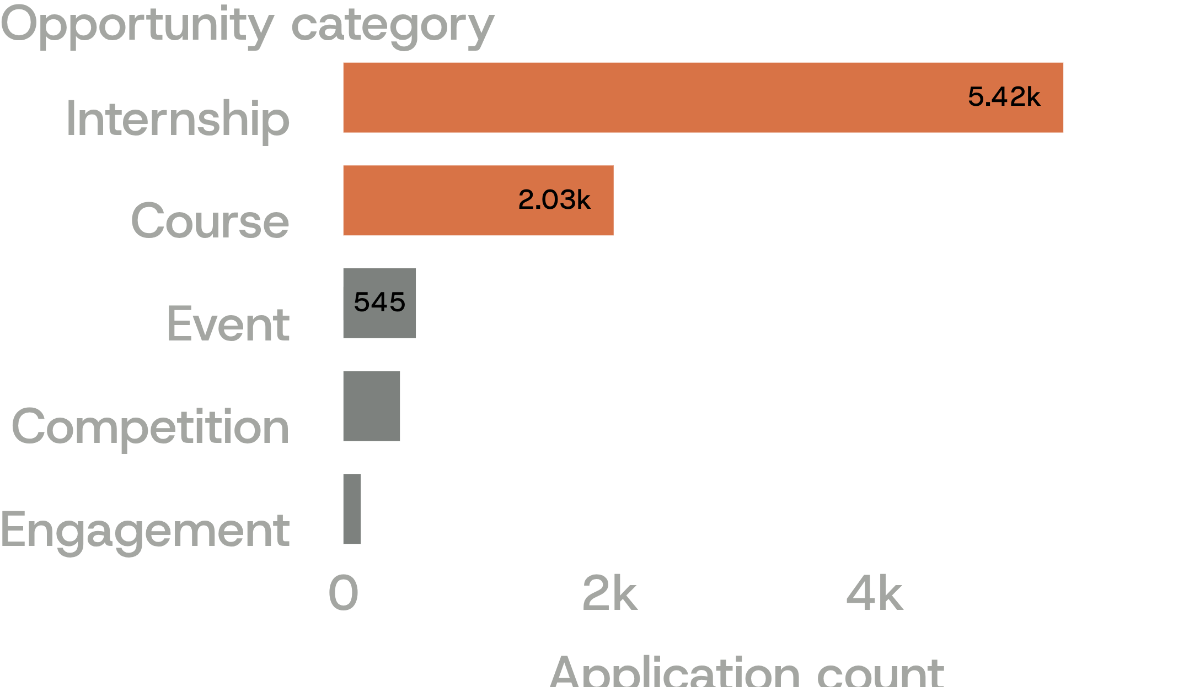


Opportunity Category Ranking
Internship and Course dominate historical application volume, together representing approximately 87.2% of 8,553 historical records.
KEY FINDINGS
STRATEGIC RECOMMENDATIONS
Internships receive the highest application volume, followed by courses. The remaining three categories collectively represent a much smaller share of applications. Both Random Forest and XGBoost predict the same category ranking.
Align staffing and capacity with internship and course demand; investigate participation barriers in lower-volume categories; validate predictions against actual application volumes; maintain category diversity based on program objectives, not application volume alone.
ML FORECAST FINDINGS
Random Forest: 99.64% reported accuracy · XGBoost: 93.10% reported accuracy
BUSINESS IMPACT AND MEASUREMENT
Category-wise application growth · Application-to-start rate · Completion and dropout rates · Forecast error
Potential data leakage was identified; reported accuracy requires further validation before operational use.
Review monthly or post-program-cycle.
Exact counts — Internship 5,419 · Course 2,034 · Event 545 · Competition 425 · Engagement 130

Slide 11
MODELING VIEW
Feature engineering expanded the modeling view
16 → 46
Random Forest
XGBoost
Primary forecasting model.
Independent cross-check.
Total features
Evaluation
34 engineered features were added.
Accuracy, precision, recall, F1-score, AUC, five-fold cross-validation, and a top-three-feature approach.
The expanded feature set broadened the modeling view.
07
Notes:
Feature engineering changed the view from 12 original features to 42 total features. Random Forest was the primary model, XGBoost was the cross-check, and evaluation used multiple metrics and validation approaches.

Slide 12
FEATURE ANALYSIS
Application timing is the strongest forecasting signal
Random Forest feature importance
Application timing
42%
Opportunity category
24%
Duration (months)
18%
Opportunity name
9%
End month
7%
Source: Week 3 s.2. Some signals may overlap; treat percentages as indicative.

Slide 13
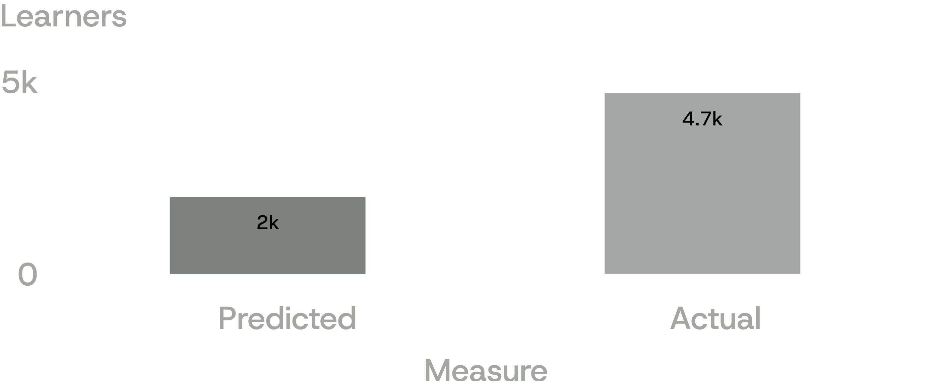
MODEL VALIDATION
High reported accuracy did not prevent a major forecast miss
94.9%
93.3%
Random Forest
XGBoost
Initially reported accuracy
Initially reported accuracy
Approximately 2,000 predicted versus 4,696 actual in one Q1 2024 comparison.
Potential leakage from outcome-related features may have inflated performance.
Application timing was reported at approximately 41–42% feature importance in one analysis; Learner Signup Quarter was reported as a leading predictor in another. 105 data anomalies were identified.
08
Notes:
The reported accuracy values look strong, but the forecast comparison shows a major miss. Potential leakage from outcome-related features may have inflated performance, and 105 anomalies further limit confidence in the result.

Slide 14
MODEL ACCURACY
Random Forest identifies Q1 as the peak
(4,924 vs 4,871 actual)
Quarterly application volume: actual vs predicted (~77% accuracy)
Actual
Random Forest
4,871
4,924
1,690
1,744
1,239
1,207
605
530
Q1
Q2
Q3
Q4
Model tables use 8,405 rows. Source: Week 3 s.8

Slide 15
MODEL INTERPRETATION
SOME KEY FINDINGS REPORTED USING THE MODEL
Application timing was reported to have approximately 41–42% feature importance in one analysis.
The analysis also identified 105 data anomalies.
A major Q1 2024 surge was substantially underestimated: approximately 2,000 predicted versus 4,696 actual in one forecast comparison.
Potential data leakage from outcome-related features may have inflated model performance.
Learner Signup Quarter was reported as a leading predictor of quarterly demand in another analysis.

Slide 16
BUSINESS INTERPRETATION
The business story is
concentrated demand
plus bounded confidence
Resource allocation
Demand planning
Engagement
Reliability
The dataset recorded 612 internship dropouts.
Leakage risk, forecast error, and 105 anomalies limit confidence.
Internships and courses represent approximately 87.2% of opportunity participation.
Q1 represented approximately 58–60% of applications in the reported analysis.
Notes:
The operating story is clear even though confidence is bounded. Demand is concentrated enough to guide attention, but leakage risk, forecast error, and anomalies mean the model should support investigation rather than be treated as a reliable forecast.

Slide 17
OPERATING CHOICES
Five actions translate the findings into operating choices
01
Align resources with demand.
02
Improve outreach timing
Prioritize internship and course capacity.
Maintain appropriate support for events, competitions, and engagement programs.
Promote suitable opportunities early.
Test early communication campaigns rather than assuming a particular lead time guarantees better outcomes.
Tailor messages to opportunity type and learner signup timing
03
Prepare for peak demand
Improve learner retention
Plan staffing, reviewer capacity, and platform readiness ahead of Q1.
Use historical monthly and quarterly trends for operational planning.
04
Investigate internship dropout patterns.
Introduce appropriate follow-ups and evaluate their effect on completion rates.
05
Improve model reliability
Remove data leakage, validate forecasts on future periods, and monitor prediction errors.
10
Notes:
These actions translate the analysis into operating choices. The first two respond to concentrated demand and seasonality. The remaining actions preserve appropriate caution around outreach timing, dropout investigation, leakage, future-period validation, and prediction error.

Slide 18
MEASUREMENT DESIGN
Measure operations and model quality separately
Operational KPIs
Demand KPIs
Application volume and rate; participation and start rate; application-to-acceptance conversion; completion and dropout rates.
Quarterly demand and forecast error.
Machine learning metrics
Trend and segment
Prediction accuracy and validation performance.
Track each measure over time and segment where relevant by country and opportunity type.

Slide 19
CONCLUSION
KEY TAKEAWAYS
01
Demand Concentration
02
Seasonal Patterns
Internships and courses account for approximately 87.2% of participation, making them the primary areas for resource allocation.
Application activity fluctuates throughout the year, with notable peaks in Q1 and August, highlighting the importance of timely outreach and capacity planning.
03
Data Driven Decisions
Random Forest and XGBoost provided a foundation for forecasting demand, but further validation is required to address potential data leakage and forecast errors.
MOVING FORWARD
RIT can use these insights to improve resource planning, target learner outreach, strengthen retention, and make more informed program decisions. Reliable data and validated forecasts will be essential to achieving these improvements.

Slide 20
THANK YOU !
Team 6 | AI Powered Data Analysis Internship | RIT

Slide 21
Presentation:
Link
Final Report:
Link

